Slide 1

analysis of house sales in King county, Washington

Slide 2
Agenda
Data Importing and Pre-Processing
Presented by Vinh Dao
Data Analysis and Visualization
Presented by Paola Rodriguez
Data Analytics
Presented by Journel Brual

Slide 3

Data Importing and Pre-Processing

Slide 4
Data Importing and Pre-Processing
Import dataset and describe characteristics such as dimensions, data types, file types, and import methods used
1
Clean, wrangle, and handle missing data
2
Transform data appropriately using techniques such as aggregation, normalization, and feature construction
3
Reduce redundant data and perform need-based discretization
4

Slide 5
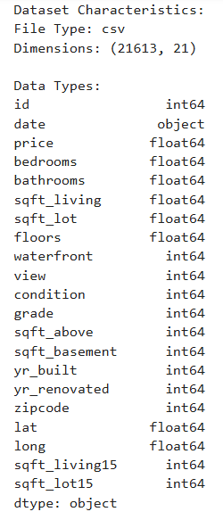
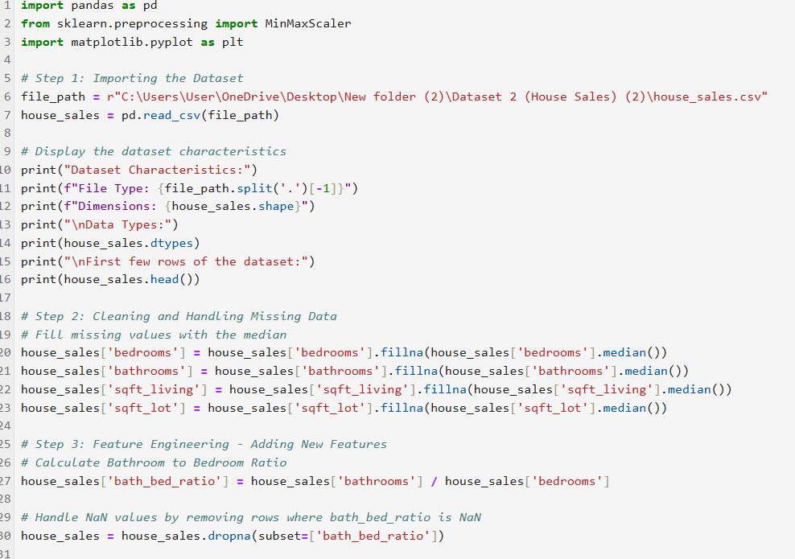
Data Importing and Pre-Processing
1. Import the Dataset
2. Fill Missing Values
3. Calculate New Features
4. Handle NaN Values

Slide 6
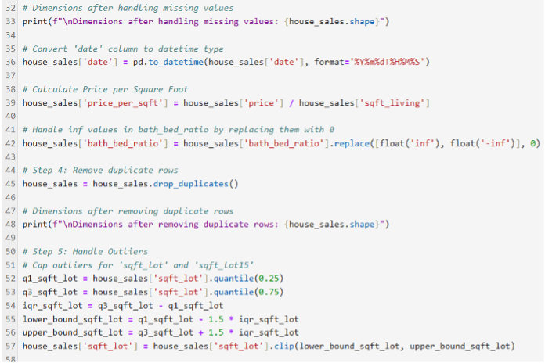
Data Importing and Pre-Processing
5. Remove Duplicate Rows
6. Handle Outliers
7. Extract Year from Date
8. Save Dataset

Slide 7
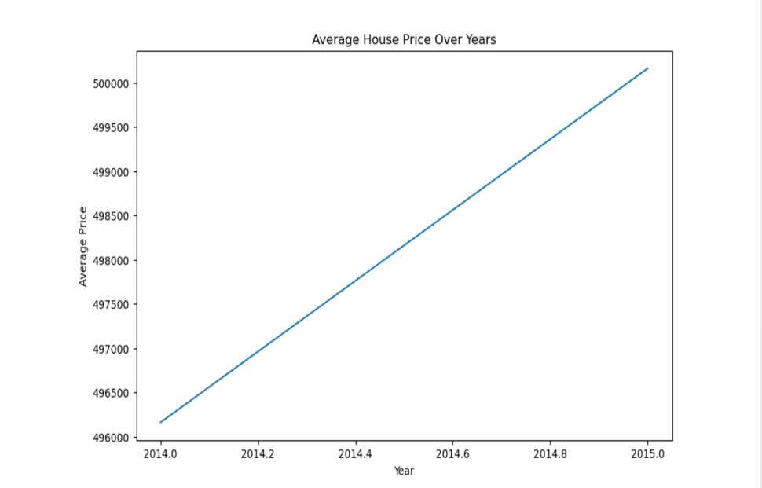
Summary of Part 1
Loading
Loading the dataset and understanding its structure.
Cleaning
Cleaning the data by handling missing values, removing duplicates, and capping outliers.
Creating
Creating new features ( age, square-living, and bath/bedroom ratio)that might be useful for modeling, such as ratios and price per square foot.
Saving
Saving the cleaned dataset for further analysis or modeling.

Slide 8

Data Analysis and Visualization

Slide 9

Data Analysis and Visualization
Identify
1
Identify categorical, ordinal, and numerical variables within the data
Provide
2
Provide measures of centrality and distribution with visualizations
Diagnose
3
Diagnose for correlations between variables and determine independent and dependent variables
Perform
4
Perform exploratory analysis in combination with visualization techniques to discover patterns and features of interest

Slide 10
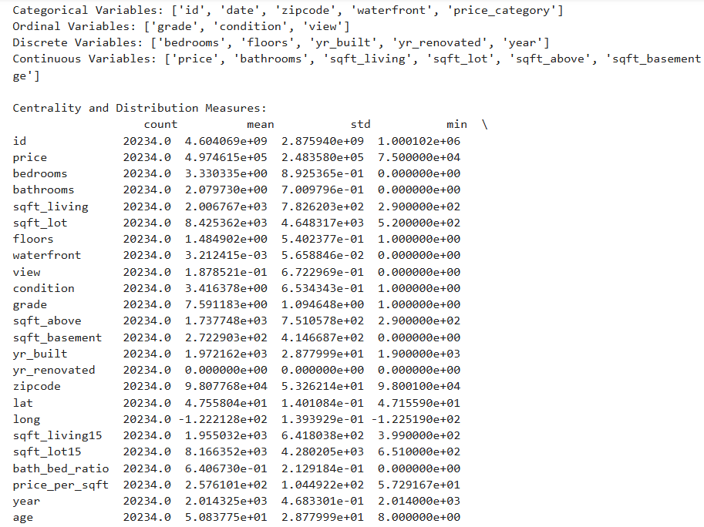
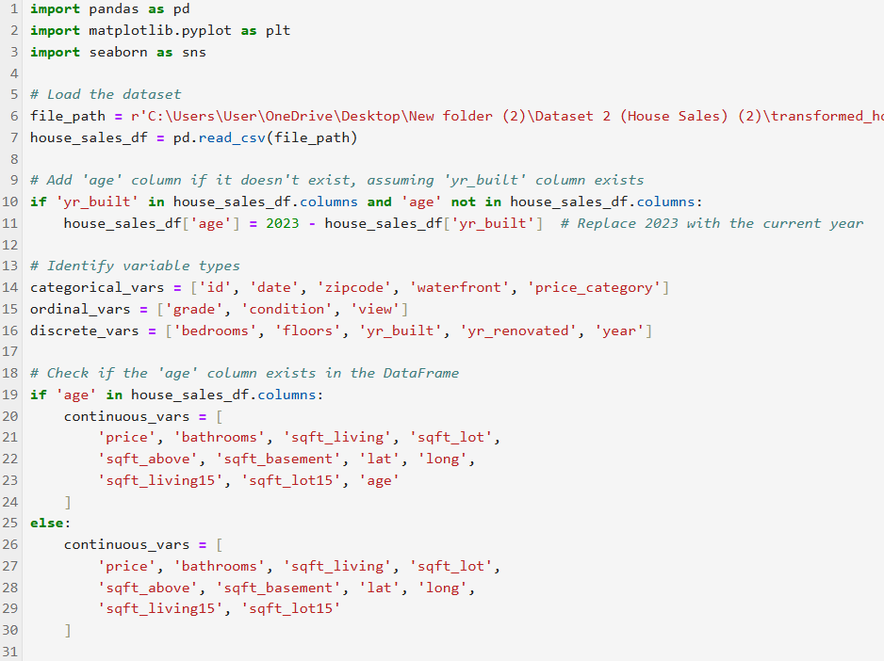
Data Analysis and Visualization
Part 1: Identify categorical, ordinal, and numerical variables within the data
1. Import Libraries and load transformed dataset
2. Add ‘age’ column
3. Identify Variable types
Categorical
Ordinal
Discrete
Continuous
Numerical

Slide 11
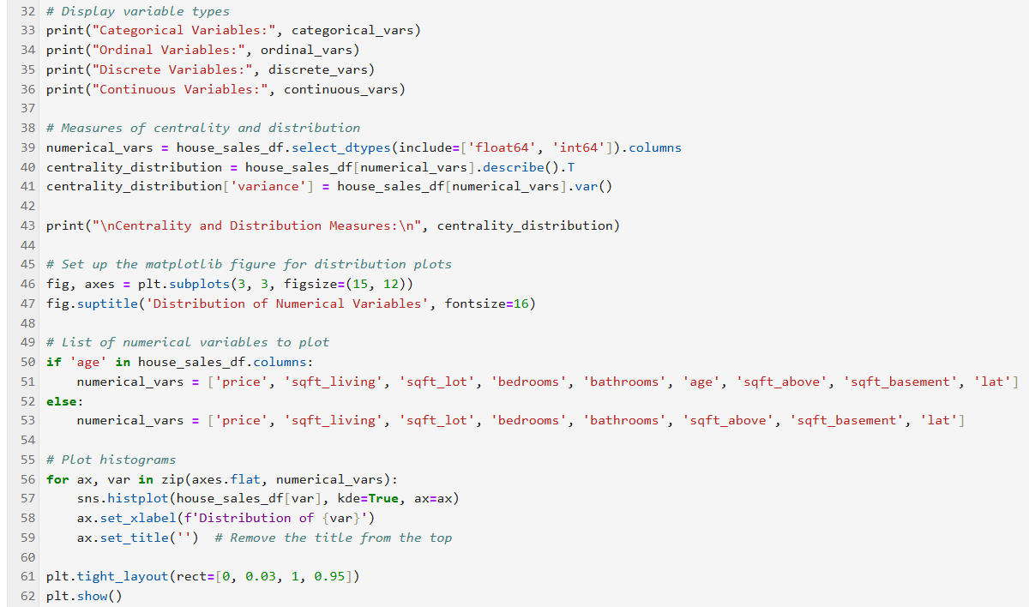
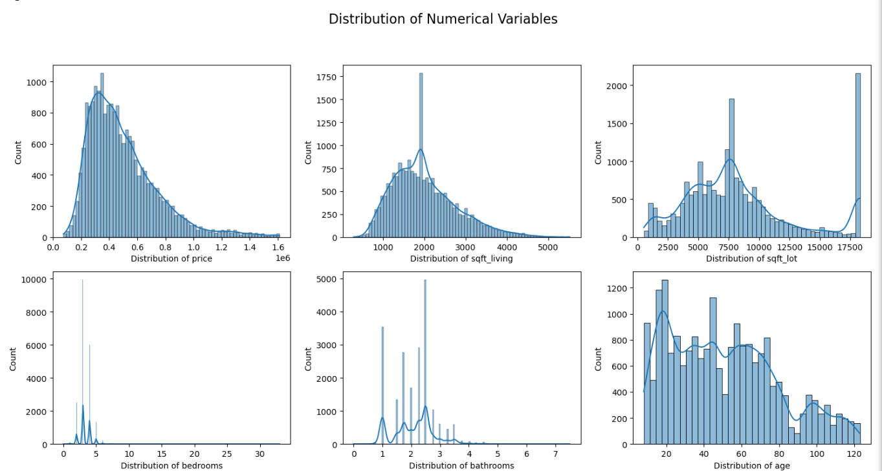
Data Analysis and Visualization
Part 2: Provide measures of centrality and distribution
with visualizations
1. Calculate Measures of Centrality and Distribution
Mean
Standard Deviation
Variance
2. Visualizations
Histograms

Slide 12

Data Analysis and Visualization
Part 3: Diagnose for correlations between variables and
determine independent and dependent variables
1. Determining Independent and Dependent Variables
2. Key Correlations
3. Correlation Matrix

Slide 13
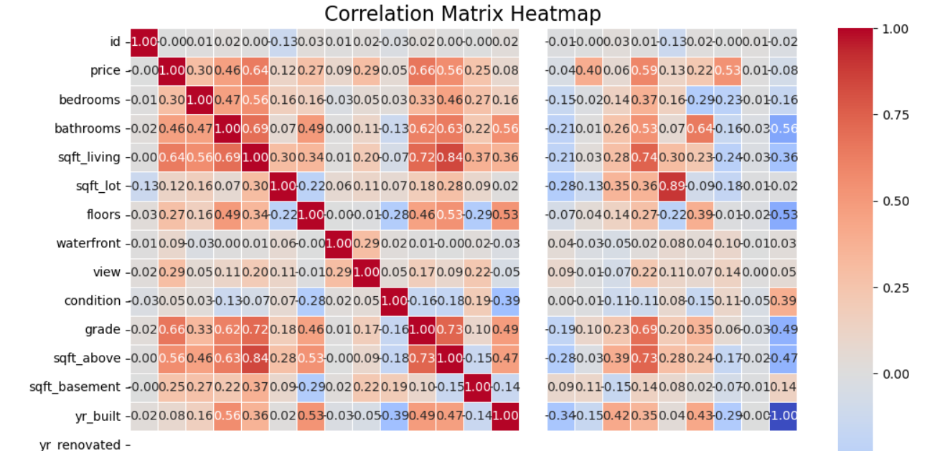
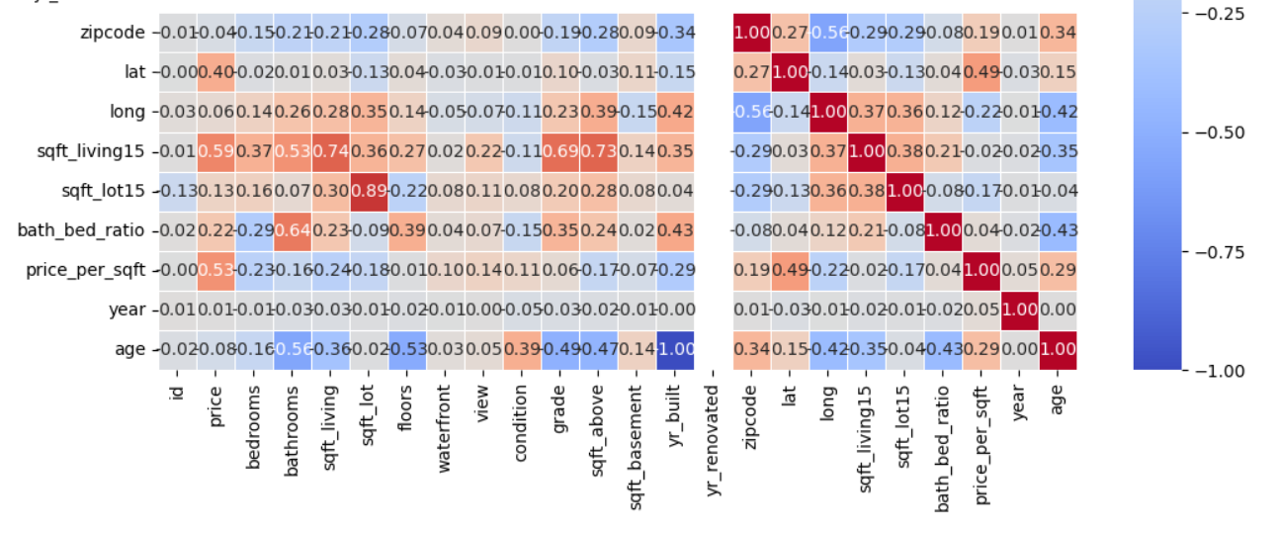
Data Analysis and Visualization- Part 3 continued
Key Correlations:
price vs. sqft_living: Strong positive correlation (0.64) suggests that larger living spaces increase house prices.
sqft_living vs. sqft_above: Strong correlation (0.88) indicates a direct relationship between above-ground space and total living area.
grade vs. price: Moderate positive correlation (0.66), indicating that homes with higher grades generally have higher prices.
bathrooms vs. sqft_living: Moderate correlation (0.69) shows that more bathrooms are associated with larger living spaces.
age vs. yr_built: Strong negative correlation (-0.49) highlights the expected inverse relationship between house age and year built.

Slide 14
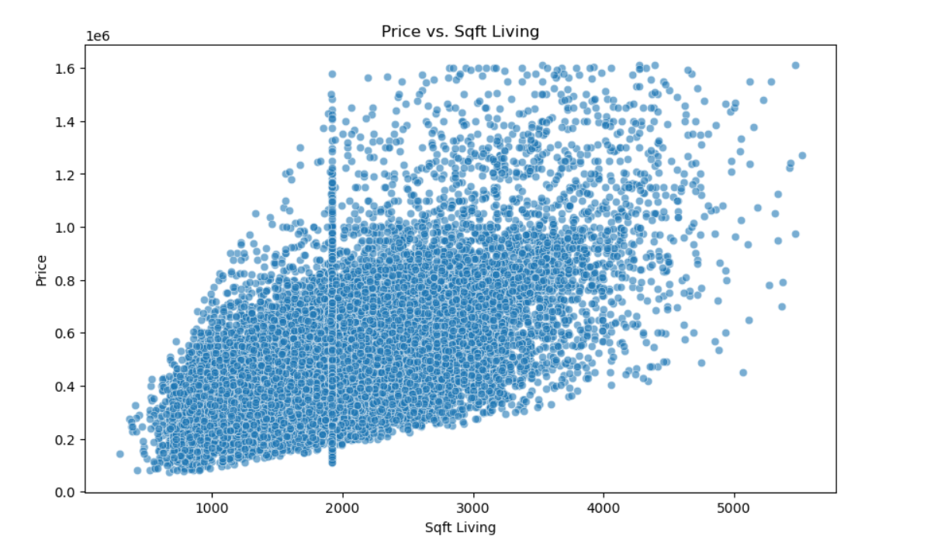
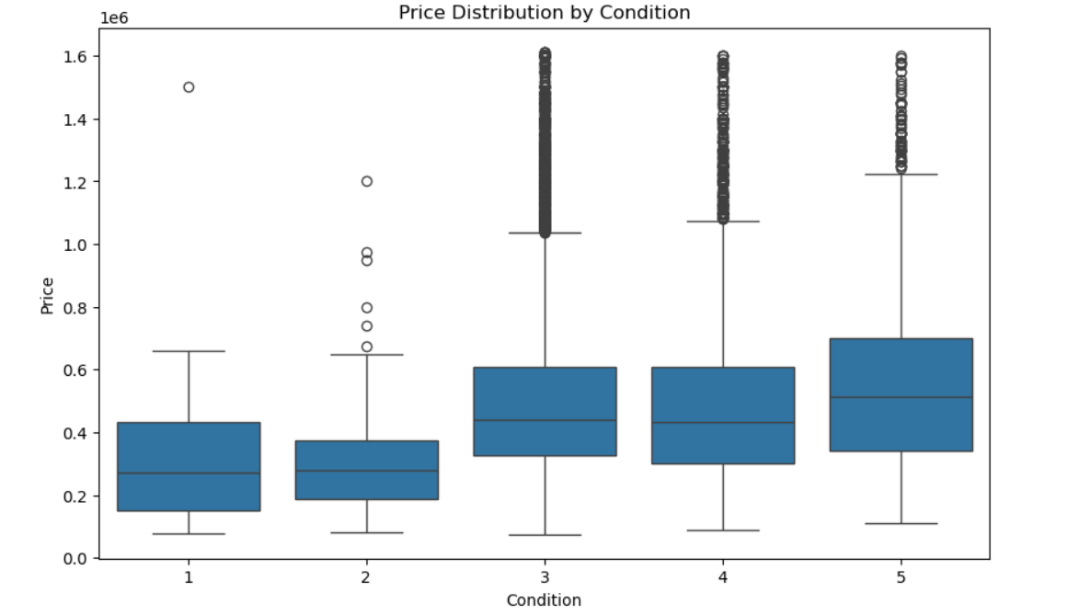
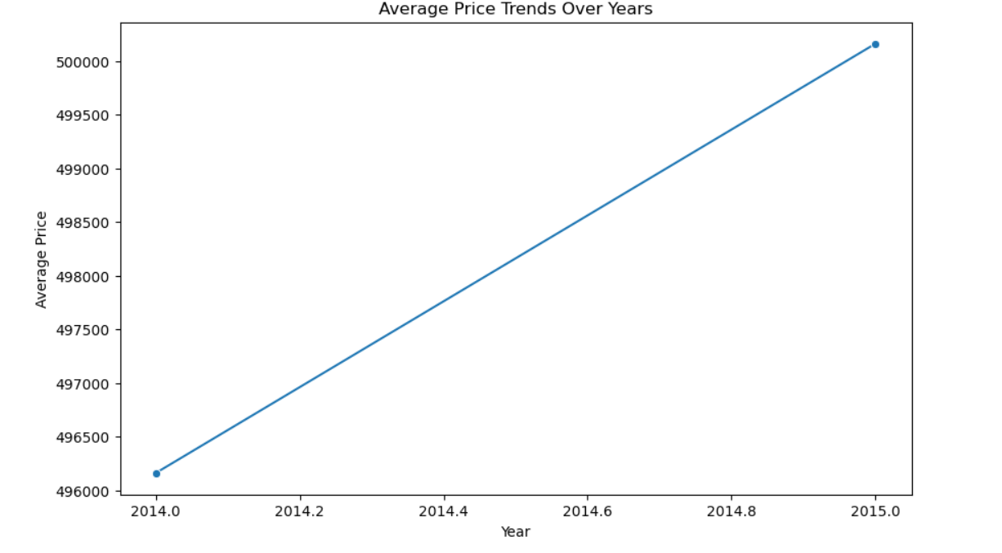
Data Analysis and Visualization
Part 4: Perform exploratory analysis in combination with visualization techniques to discover patterns and features of interest
1. Exploratory Analysis
Scatter Plot
Box Plots
Line Plots

Slide 15
Summary of Part 2
The exploratory analysis and visualizations of the house sales dataset reveal key insights into the various variables.
The dataset includes categorical, ordinal, discrete, and continuous variables, with notable skewness in distributions.
Visual patterns from scatter plots and box plots further demonstrate the relationships between these variables, with grade and living space emerging as crucial factors in determining house prices.
Temporal trends indicate an upward trend in the market, with condition and grade also impacting price distributions

Slide 16
Data Analytics

Slide 17

Data Analytics
Part 1: Determine the need for a supervised or unsupervised learning method and identify dependent and independent variables
Part 2: Train, test, and provide accuracy and evaluation metrics for model results

Slide 18
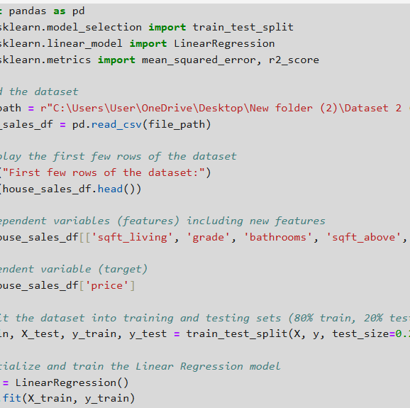
Data Analytics
Part 1: Determine the need for a supervised or unsupervised learning method and identify dependent and independent variables
Determine the Need for a Supervised or Unsupervised Learning Method
Supervised Learning
Defining Independent and Dependent Variables
X: This is the DataFrame containing the independent variables (features) that will be used to predict the target variable
Y: This is the target variable (dependent variable) we want to predict, which is the price of the house.

Slide 19
Data Analytics
Part 1 continued: Identify dependent and independent variables
Dependent Variable (Target):
Price
Independent Variables (Features):
sqft_living: Square footage of living area
grade: Quality rating of the house
bathrooms: Number of bathrooms
sqft_above: Square footage of the house above ground
sqft_lot: Square footage of the lot
condition: Condition of the house
floors: Number of floors
price_per_sqft: Price per square foot
bath_bed_ratio: Ratio of bathrooms to bedrooms

Slide 20
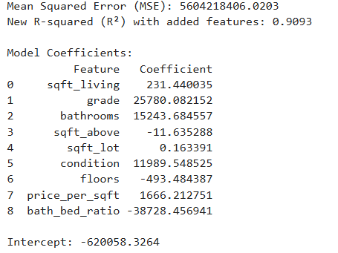
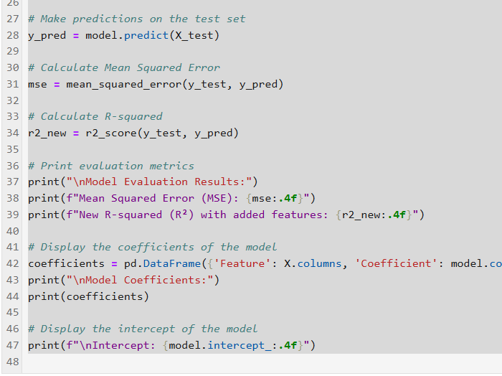
Data Analytics
Part 2: Train, test, and provide accuracy and evaluation metrics for model results
Splitting the Dataset into Training and Testing Sets
Train_test_split: This function splits the dataset into training and testing sets.
Calculating and Displaying Evaluation Metrics
Displaying the Intercept of the Model

Slide 21
Summary of Part 3
Determine Need for Supervised Learning Method and Identified Dependent and Independent Variables.
Model Training and Evaluation
Performance Metrics used: Mean Squared Error and R-Squared
Key Insights: Strong Predictors and Model Performance

Slide 22

Conclusion
The analysis effectively demonstrates the application of a supervised learning method (Linear Regression) to predict house prices using key features.
The model's performance is evaluated using appropriate metrics, and the significance of each feature is interpreted.
The insights gained can inform further analysis and decision-making in real estate pricing.

Slide 23

Thank you!

